Slide 1
Pipeline Processing

Slide 2
PIPELINING
A technique of decomposing a sequential process into sub operations, with each sub process being executed in a partial dedicated segment that operates concurrently with all other segments.
A pipeline can be visualized as a collection of processing segments through which binary information flows.
A pipeline can be visualized as a collection of processing segments through which binary information flows.
The name “pipeline” implies a flow of information analogous to an industrial assembly line.

Slide 3
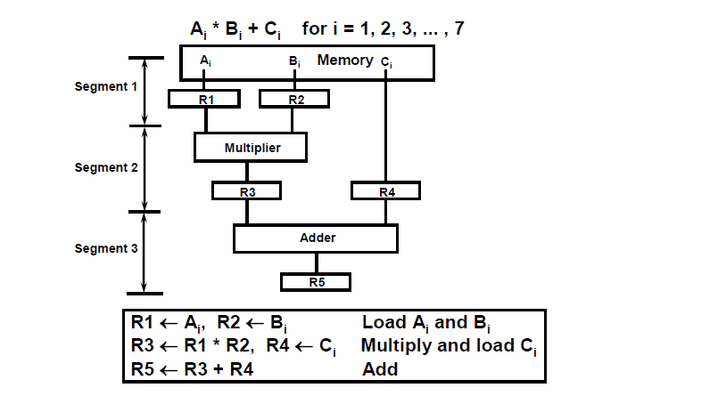
Example of the Pipeline Organization

Slide 4
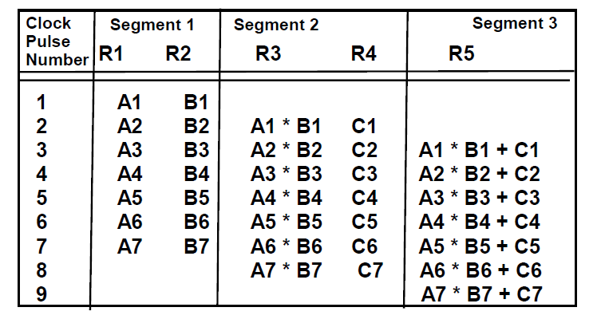
OPERATIONS IN EACH PIPELINE STAGE

Slide 5
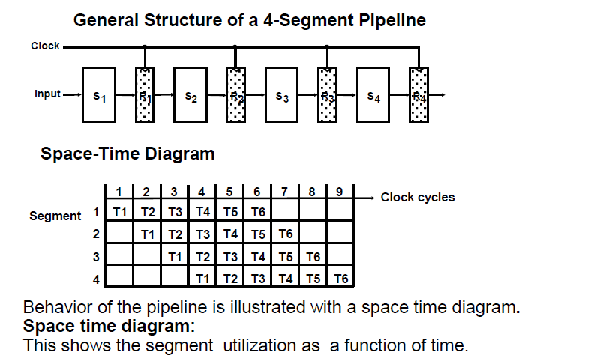
GENERAL PIPELINE

Slide 6
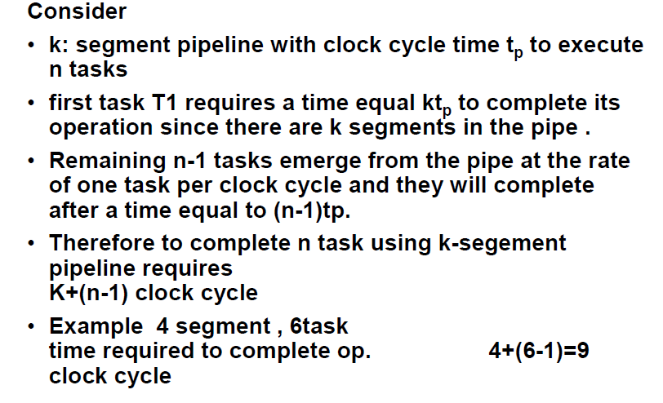
Speedup ratio of pipeline

Slide 7
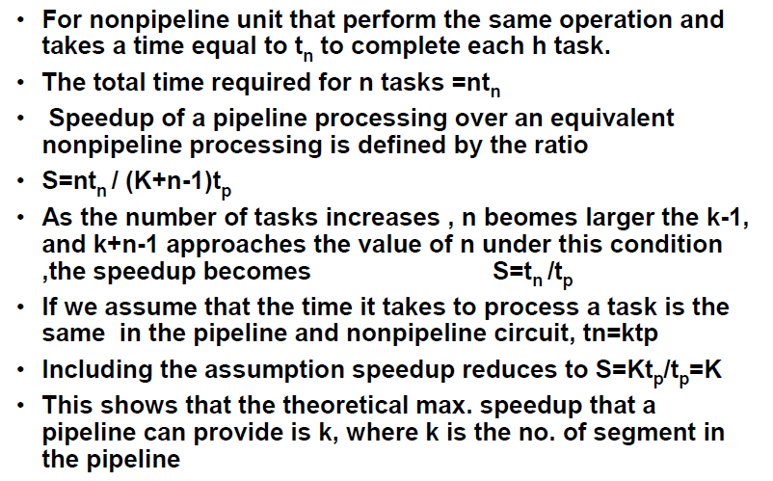
Cont.

Slide 8
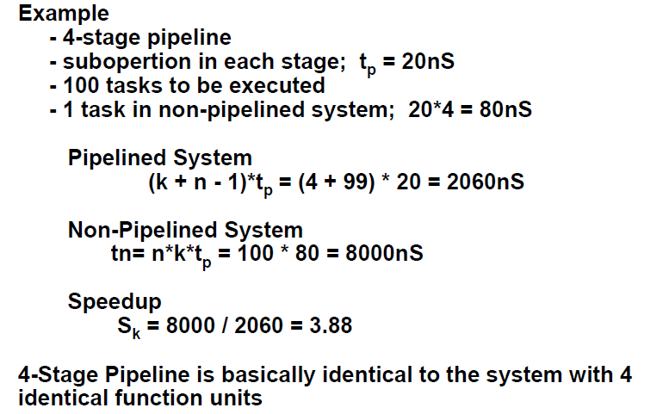
PIPELINE AND MULTIPLE FUNCTION UNITS

Slide 9
4-Stage instruction Pipelining
S1
S2
S3
S4
S5
Fetch
Instruction
(FI)
Decode
Instruction
(DI)
Fetch
Operand
(FO)
Execution
Instruction
(EX)
Time
Fetch instruction (FI)
Decode instruction (DI)
Fetch operands (FO)
Execute instructions and store result (EX)

Slide 10
Clock Cycle
 | 1 | 2 | 3 | 4 | 5 | 6 | 7
1 | FI | DI | FO | EX
2 |  | FI | DI | FO | EX
3 |  |  | FI | DI | FO | EX
4 |  |  |  | FI | DI | FO | EX
Instruction

Slide 11
Pipeline Hazards
There are situations, called hazards, that prevent the next instruction in the instruction stream from executing during its designated cycle
There are three classes of hazards
  Structural hazard
  Data hazard
  Branch hazard

Slide 12
Pipeline Hazards
Structural hazard
  Resource conflicts when the hardware cannot support all possible combination of instructions simultaneously
Data hazard
  An instruction depends on the results of a previous instruction
Branch hazard
  Instructions that change the value of PC

Slide 13
Structural hazard
It is caused by access to memory by two segment of pipeline at the same time.
Some pipeline processors have shared a single-memory pipeline for data and instructions.

Slide 14
Structural hazard
If the EX segment needs to store the result of operation in the data memory, while at the same time FI segment needs to fetch the instruction from memory.
This can be resolved by using separate instruction and data memories.

Slide 15
Structural hazard
To solve this hazard, we “stall” the pipeline until the resource is freed
A stall is commonly called pipeline bubble, since it passes through the pipeline taking space but carry no useful work

Slide 16
Data Dependencies
Three types of data dependencies defined in terms of how succeeding instruction depends on preceding instruction
  RAW: Read after Write or Flow dependency
  WAR: Write after Read or anti dependency
  WAW: Write after Write or output dependency

Slide 17
Three Generic Data Hazards
Read After Write (RAW)
Instr_{J} tries to read operand before Instr_{I} writes it.
I: add r1,r2,r3
J: sub r4,r1,r3

Slide 18
RAW Dependency
Example program (a) with two instructions
  i1: load r1, a;
  i2: add r2, r1,r3;
Program (b) with two instructions
  i1: mul r1, r4, r5;
  i2: add r2, r1, r3;
Both cases we cannot read in i2 until i1 has completed writing the result

Slide 19
Three Generic Data Hazards
Write After Read (WAR)
Instr_{J} writes operand before Instr_{I} reads it
Called as “anti-dependence”
I: sub r4,r1,r3
J: add r1,r2,r3
K: mul r6,r1,r7

Slide 20
Three Generic Data Hazards
Write After Write (WAW)
Instr_{J} writes operand before Instr_{I} writes it.
Called as “output dependence”
I: sub r1,r4,r3
J: add r1,r2,r3
K: mul r6,r1,r7

Slide 21
WAR and WAW Dependency
Example program (a):
  i1: mul r1, r2, r3;
  i2: add r2, r4, r5;
Example program (b):
  i1: mul r1, r2, r3;
  i2: add r1, r4, r5;
both cases we have dependence between i1 and i2
  in (a), r2 must be read before it is written into
  in (b), r1 must be written by i2 after it has been written by i1

Slide 22
Data hazard
Example:
ADD R1←R2+4
SUB R4←R1-R5
ADD
SUB
FI | DI | FO R2=10 | EX R1=14
 | FI | DI | FO R1=? | EX

Slide 23
Delayed load
Delayed load approach inserts a no-operation instruction to avoid the data conflict
ADD R1←R2+R3
NOP
SUB R4←R1-R5
FI | DI | FO R2=10 | EX R1=14
 | FI | DI | FO | EX
 |  | FI | DI | FO R1=14 | EX
ADD
NOP
SUB

Slide 24
Operand Forwarding
It can be further solved by a simple hardware technique called forwarding (also called bypassing or short-circuiting)
Control hardware checks the destination operand.
If it is needed as a source in the next instruction, it passes the result directly into the ALU input, bypassing the register file.

Slide 25
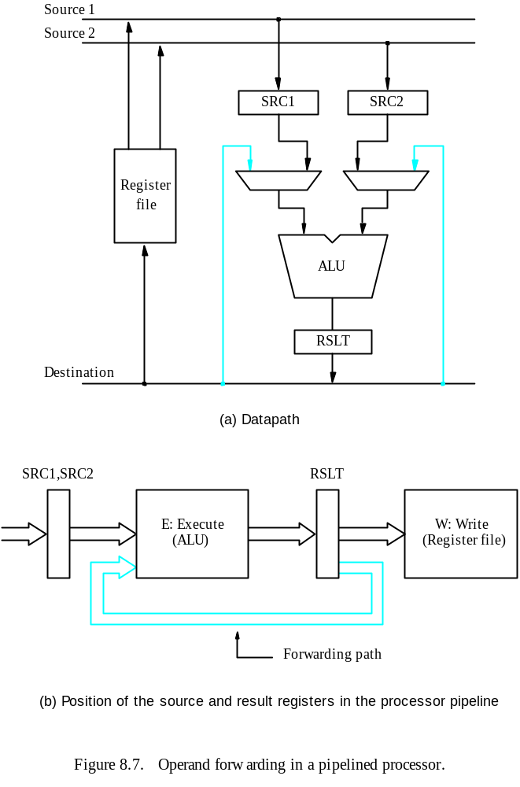

Slide 26


Compiler Optimization
Compiler has to be optimized to reorder instructions in order to avoid problems with data dependencies.

Slide 27
Control Hazards
This conflicts arise from branch and other instructions that change the value of PC.
Two types of control hazards.
Unconditional branch:- Always alter the sequential program flow by loading PC with the target address.
    JMP 2000
Conditional branch:-
  Control selects the target instruction if condition is satisfied.
  Control selects the next sequential instruction if condition is not satisfied.
    JNC 2050

Slide 28
Control Hazards
1000: R1<- Load[memory]
1001: R3<-R3+ R4
1002: JMP 2050
1003: R2<- R5+ R6
As soon as Instruction 3 is decoded in the DI, transfer from FI to DI of the instruction 4 will be halted.
Branch instruction delays the pipeline until PC is loaded with the branch target address.
 | 1 | 2 | 3 | 4 | 5 | 6 | 7 | 8 | 9 | 10
1 | FI | DI | FO | EX
2 |  | FI | DI | FO | EX
3 |  |  | FI | DI | FO | EX
4 |  |  |  | FI | - | - | FI | DI | FO | EX
Branch
Inst from 2050
Inst from 1003

Slide 29
Control Hazards
Solutions:
  Delayed Branch
  Branch target buffer (BTB)
  Prefetch target instruction
  Branch Prediction

Slide 30
Delayed Branch
Insert 3 NOP after branch instruction to maintain continuous flow of pipeline. This technique is called delayed branch.
 | 1 | 2 | 3 | 4 | 5 | 6 | 7 | 8 | 9 | 10
1 | FI | DI | FO | EX
2 |  | FI | DI | FO | EX
Branch |  |  | FI | DI | FO | EX
NOP |  |  |  | FI | DI | FO | EX
NOP |  |  |  |  | FI | DI | FO | EX
NOP |  |  |  |  |  | FI | DI | FO | EX
Inst from 2050 |  |  |  |  |  |  | FI | DI | FO | EX
R1<- Load[memory]
R3<-R3+ R4
JMP 2050
NOP
NOP
NOP
INSTRUCTION FROM 2050

Slide 31
Compiler optimization
(Rearrange the Instruction)
In this procedure, the compiler detects the branch instruction and rearrange the instruction sequence by inserting useful instructions in the delayed slot to maintain continuous flow of pipeline.

Slide 32
Branch target buffer (BTB)
BTB is an associative memory
Each entry in the BTB consists of the address of a previously executed branch instruction and the target instruction for the branch.
When pipeline decodes a branch instruction, it searches BTB for target instruction.
  If found, instruction will be fetched directly from BTB.
1000: R1<- Load[memory]
1001: R3<-R3+ R4
1002: JMP 2050
1003: R2<- R5+ R6
Address of Branch | Target Address
1002 | 2050

Slide 33
Prefetch target instruction
Prefetch the target instruction in addition to the instruction following the branch.
Fetch instruction in both path, branch taken and branch not taken.
Both are saved until the branch is executed.
Then select instruction from right path and discard the wrong path.

Slide 34
Branch Prediction
A pipeline with branch prediction uses some additional logic to guess the outcome of a conditional branch instruction before it is executed
The idea is to assign a prediction bit P to the branch instruction when it is first executed.
Then pipeline begins prefetching the instruction from the predicted path.
A correct prediction eliminates the wasteful time caused by branch penalties.

Slide 35
Branch Prediction
I: JNC 2000 <P>
If P=1 -> prediction is to go 2000
P predicts whether branch will occur or not.
When loop iteration is controlled by I, once the loop execution path is entered P predicts that the same loop path will be followed each time I will encountered.
Misprediction eventually results when loop is exited, but it can be expected to be right most of the time.

